Slide 1


Department of Electronics and Communication Engineering
POLYNOMIAL REGRESSION
Name | USN
Omkar Kalghatgi | 02FE21BEC053
Aleena Mulla | 02FE21BEC006
Rakshita Kusanale | 02FE21BEC069
Pratik Patil | 02FE21BEC063
Under the guidance of: Prof. Dattaprasad Torse
Dept. of ECE

Slide 2
Content
Sl No. | Title
1 | Problem Statement
2 | Method
3 | Code
4 | Simulation
Dept. of ECE

Slide 3
Problem Statement:
Predicting the salary of a person based on their Position in the company

Slide 4
Methods used:
POLYNOMIAL REGRESSION:
Polynomial regression is a type of regression analysis that models the relationship between independent and dependent variables as an nth degree polynomial.
Dept. of ECE

Slide 5
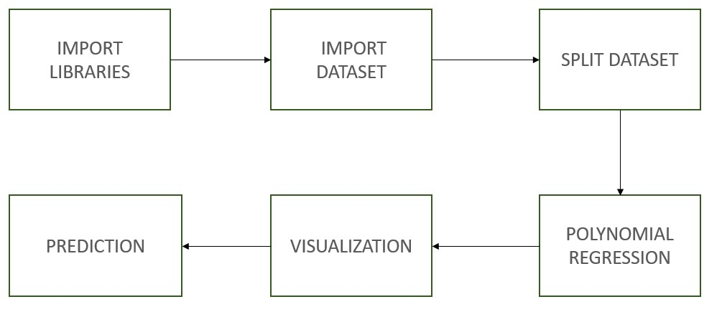
BLOCK DIAGRAM

Slide 6
CODE:
#Import the necessary libraries
import numpy as np
import pandas as pd
import matplotlib.pyplot as plt
#Import the dataset
dataset = pd.read_csv(r"/kaggle/input/salary/Position_Salaries.csv")
#Splitting the dataset in to I.V(x) and D.V(y)
x = dataset.iloc[:, 1:2].values
y = dataset.iloc[:, 2].values
#Our main goal is to predict if this employee is bluffing by building machine learning model that is polynomial regression model
#fit the lin_reg object to x & y. Now our simple linear regression is ready
from sklearn.linear_model import LinearRegression
lin_reg = LinearRegression()
lin_reg.fit(x,y)

Slide 7
#Fitting Polynomial Regression to the dataset
from sklearn.preprocessing import PolynomialFeatures
poly_reg = PolynomialFeatures(degree=5)
x_poly = poly_reg.fit_transform(x)
poly_reg.fit(x_poly,y)
#we crate an 2nd object for same LinearRegression
lin_reg_2 = LinearRegression()
lin_reg_2.fit(x_poly, y)
#Visualising the Polynomial Regression results
plt.scatter(x, y, color = 'red')
plt.plot(x, lin_reg_2.predict(poly_reg.fit_transform(x)), color = 'blue')
#in y-coordinate we have to replace with lin_reg2 which we create for poly regression model
#x_poly is not defined cuz we already defined in above plot, so insted of x_poly we will define complete fit_trasnform code
plt.title('(Polynomial Regression)')
plt.xlabel('Position level')
plt.ylabel('Salary')
plt.show()
# Predicting a new result with Polynomial Regression
lin_reg_2.predict(poly_reg.fit_transform([[6.5]]))
#This code show me that predicted salary of 6.5 level using poly reg model
lin_reg_2.predict(poly_reg.fit_transform([[7.5]]))
lin_reg_2.predict(poly_reg.fit_transform([[8.5]]))
lin_reg_2.predict(poly_reg.fit_transform([[11.5]]))

Slide 8
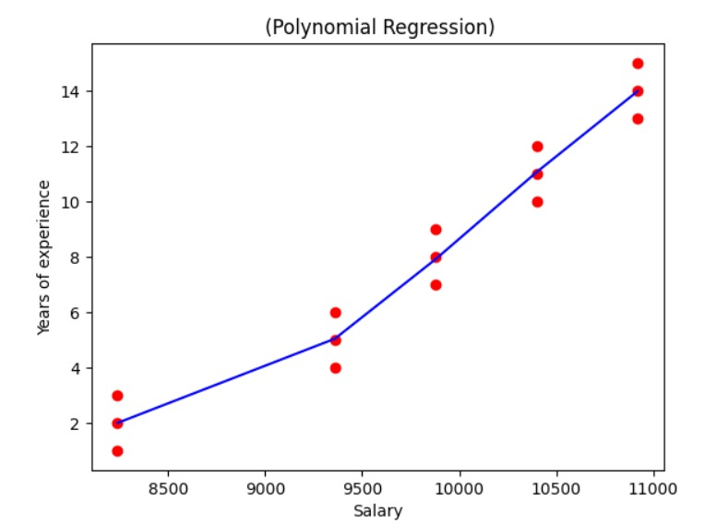
Simulations

Slide 9
PROJECT LINK
https://github.com/pratikpp105/ML-Polynomial-Regression-/blob/main/ML%20PPT%20(final).pptx.

Slide 10
REFRENCES
Heiberger, Richard M., et al. "Polynomial regression." R Through Excel: A Spreadsheet Interface for Statistics, Data Analysis, and Graphics (2009): 269-284.
Ostertagová, Eva. "Modelling using polynomial regression." Procedia Engineering 48 (2012): 500-506.
Seber, George AF, and Alan J. Lee. "Polynomial regression." Linear Regression Analysis (2003): 165-185.

Slide 11
Thank You
Dept. of ECE

